Slide 1
Project Monitoring System (PMS)
Real Time Monitoring System for School Education

Slide 2
Major features
Major features
To manage the implementation of RMSA scheme, a Project Monitoring System (PMS) was developed during 2014;
Now extended to cover the Integrated Scheme for School Education
PMS will facilitate the States and UTs to view
Online submission of AWP&B
Approved outlays
Status of GoI Releases
Facility of on line submission of Monthly Physical and Financial Progress Reports
Appraisals of the State plans and approvals of schools, cancellations etc. would be done as per UDISE coverage.

Slide 3
Major features
To streamline the process of online submission of State Plan
To expedite approvals and transfers of funds to States and UTs
Transparency and accuracy in physical and financial management
Paperless
Real-time

Slide 4
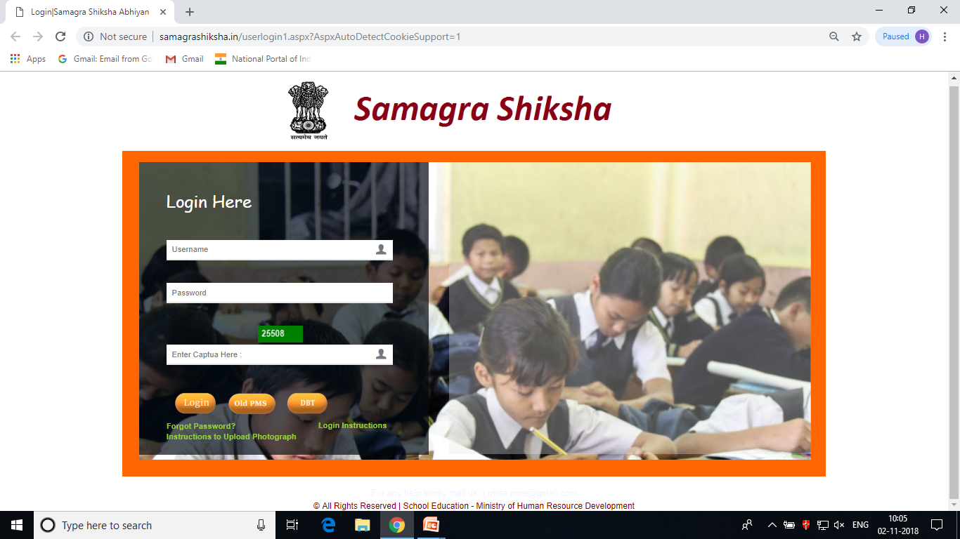
Overview
Website :
http://samagra.mhrd.gov.in or www.samagrashiksha.in
Screening
Entry Level
Authorization Level

Slide 5
User - Levels
National – 46 (Active – 46)
Total
11.57 L
State / UTs – 144 (Active – 131) – 4 user for each State
Super User : 36/36, Elementary : 33/36, Secondary : 33/ 36 , Teacher Education : 27/36
Districts – 2872 (Active – 935) – 4 user for each District
Super User : 150/718, Elementary : 147/718, Secondary : 610/ 718 , TE : 28/718
Blocks– 7505 (Active – 1337)
Schools – 11.47 L (Active – 72775)

Slide 6
User – Definition
Can be fetched from 11 digit UDISE code of Schools
22 01 02 03 004
School (11 Digit UDISE code)
State (2 Digit)
District (4 Digit district code : 2201)
Block (6 Digit Block code : 220102)

Slide 7
Login – Definition
State Level
Super User – 2 Digit State Code
Elementary – “U1” + State Code
Secondary – “U2” + State Code
TE – “U3” + State Code
District Level
Super User – 4 Digit District Code
Elementary – “U1” + District Code
Secondary – “U2” + District Code
TE – “U3” + District Code

Slide 8
Login – Definition
Block Level
6 Digit Block Code
School Level
11 Digit School Code

Slide 9
Password – Definition
The default password is :
State Level : 2 Digit State Code
District Level : 4 Digit District Code
Block Level : 6 Digit Block Code
School level : 11 Digit UDISE Code

Slide 10
Freezing Password – Definition
The default password is :
State Level : “ST” + Login name
District Level : “ST” + Login name
Block Level : no password
School Level : no password

Slide 11
Locking / Screening Level
The screening level was given at Block / District / State level for physical progress :
If anything is modified by School can be Freeze and rejected by Block User
If anything is modified by Block can be Freeze and rejected by District user
if anything is modified by District can be Freeze and rejected by State user
Note : Last date of freezing the physical progress is 10th of every month. If any level skipped the freezing procedure which was updated by any level than system will lock the progress and cannot be reverted back . (The such cases will be apply on Completed works and Functional status only)

Slide 12
What to do at School Login ?
The following module have been given under school login to enter the physical progress approved by PAB every year :
New School : Construction / Functional Status with Photographs and Completion Certificate
Strengthening : Level wise construction status for Elementary / Secondary / Hr. Secondary
Toilet : Construction Status by Number’s with Photographs
Water : Construction Status by Number’s
ICT : Functional Status
Vocational Education : Functional Status / Placement Details / Monthly Progress
CWSN : Child wise entry of differently-abled boys / girls
Residential School : Functional Status

Slide 13
On-line Demonstration of School Login

Slide 14
What to do at Block Login ?
The following module have been given under block login to enter the physical progress approved by PAB every year for the concern block:
New School : Construction / Functional Status with Photographs and Completion Certificate
Strengthening : Level wise construction status for Elementary / Secondary / Hr. Secondary
Toilet : Construction Status by Number’s with Photographs
Water : Construction Status by Number’s
ICT : Functional Status
Vocational Education : Functional Status / Placement Details / Monthly Progress
CWSN : Child wise entry of differently-abled boys / girls
Residential School : Functional Status
Residential Hostel: Functional Status

Slide 15
Freezing Module at Block Login
The following module have been given under block login to freeze and reject the physical progress entered by the School and shown Completed / Functional:
New School : Construction / Functional Status
Strengthening : Construction status for Elementary / Secondary / Hr. Secondary
Toilet : Construction Status by Number’s
Water : Construction Status by Number’s
ICT : Functional Status
Vocational Education : Functional Status
Residential School : Functional Status
Note : All Civil Work approved by PAB for the district should be freeze

Slide 16
On-line Demonstration of Block Login

Slide 17
What to do at District Login ?
The following module have been given under District login to enter the physical progress approved by PAB every year for the concern District:
New School : Construction / Functional Status with Photographs and Completion Certificate
Strengthening : Level wise construction status for Elementary / Secondary / Hr. Secondary
Toilet : Construction Status by Number’s with Photographs
Water : Construction Status by Number’s
ICT : Functional Status
Vocational Education : Functional Status / Placement Details / Monthly Progress
CWSN : Child wise entry of differently-abled boys / girls
Residential School : Functional Status
Residential Hostel: Functional Status

Slide 18
Freezing Module at District Login
The following module have been given under District login to freeze and reject the physical progress entered by the Block and shown Completed / Functional:
New School : Construction / Functional Status
Strengthening : Construction status for Elementary / Secondary / Hr. Secondary
Toilet : Construction Status by Number’s
Water : Construction Status by Number’s
ICT : Functional Status
Vocational Education : Functional Status
Residential School : Functional Status
Residential Hostels : Functional Status
Note : All Civil Work approved by PAB for the district should be freezed

Slide 19
On-line Demonstration of District Login

Slide 20
Physical Progress at State / UTs Login
The following module have been given under State/UTs login to enter the physical progress approved by PAB every year :
Go to option , Physical Progress → Progress
New School : Construction / Functional Status with Photographs and Completion Certificate
Strengthening : Level wise construction status for Elementary / Secondary / Hr. Secondary
Toilet : Construction Status by Number’s with Photographs
Water : Construction Status by Number’s
ICT : Functional Status
Vocational Education : Functional Status / Placement Details / Monthly Progress

Slide 21
Physical Progress at State Login
CWSN : Child wise entry of differently-abled boys / girls
Residential School : Functional Status
Residential Hostel: Functional Status
The separate module has been given for elementary education (Sarva Shiksha Abhiyan) to enter the Progress of the component approved under Civil Work before 2018-2019
The cumulative progress will be entered by the State / UTs on the Civil Backlog module given under Progress → Strengthening → Civil SSA Backlog option

Slide 22
Freezing Module at State Login
The following module have been given under State login to freeze and reject the physical progress entered by the District and shown Completed / Functional:
New School : Construction / Functional Status
Strengthening : Construction status for Elementary / Secondary / Hr. Secondary
Toilet : Construction Status by Number’s
Water : Construction Status by Number’s
ICT : Functional Status
Vocational Education : Functional Status
Residential School : Functional Status
Residential Hostels : Functional Status
Note : All Civil Work approved by should be freezed

Slide 23
Financial Progress at State Login
Following steps to be followed to submit the financial progress to MHRD on PMS :
Enter the Physical & Financial Expenditure for Non-recurring
Enter the Physical & Financial Expenditure for Recurring
Check the Expenditure Report , Non-recurring report will be generated after freezing
Freeze the Expenditure
Enter GoI Fund transfer from State Government in SIS Account
Freeze the GOI Fund transfer in SIS Account
Enter State Share received against GOI Fund from State Government
Freeze the State Share received in SIS Account
Enter the Financial Statement
All figure regarding opening balance, Funds received from GOI, State Share Received, Expenditure will come automatically from previous modules
Enter the Interest , Other receipts (if any) and Submit the Statement
Freeze the Financial Statement

Slide 24
Financial Progress for Non-Recurring
Cumulative figure (since starting of Samagra Shiksha including Spill over) should be entered under Physical and Financial Expenditure
Example:
  Rs. 50 Cr have been approved under Non-recurring under Samagra Shiksha in AWP&B 2018-19 as a Spillover (A)
  Rs. 100 Cr have been approved under Non-recurring under SS as a Fresh approval in AWP&B 2018-2019 (B)
  So , the cumulative approval will be Rs. 150 Cr (A + B)
  Every month the cumulative expenditure should be entered from Rs. 150 Cr only (don’t enter progressive expenditure occurred in each month)
It is mandatory to enter the Non-recurring expenditure every month if there is no expenditure
Just open the Non-recurring expenditure module , it will show the previous figures that you have entered in previous month. Simply save it , if there is zero expenditure

Slide 25
Financial Progress for Non-Recurring
Next Financial Year onwards :
Example :
  Rs. 150 Cr have been approved under Non-recurring under Samagra Shiksha in AWP&B 2018-19 (A)
  Rs. 35 Cr have been approved under Non-recurring under SS as a Fresh approval in AWP&B 2019-2020 (B)
  So , the cumulative approval will be Rs. 185 Cr (A + B)
  Note : Every month the cumulative expenditure should be entered from Rs. 185 Cr (Means, every month of each year cumulative progress will be entered under non-recurring module. Please don’t enter progressive expenditure occurred in each month otherwise expenditure will come negative in the report)
  The system is following formula to calculate the Expenditure of Current year
    Expenditure = Current year Cumulative Expenditure (2019-20) – Previous year Cumulative Expenditure (2018-19)

Slide 26
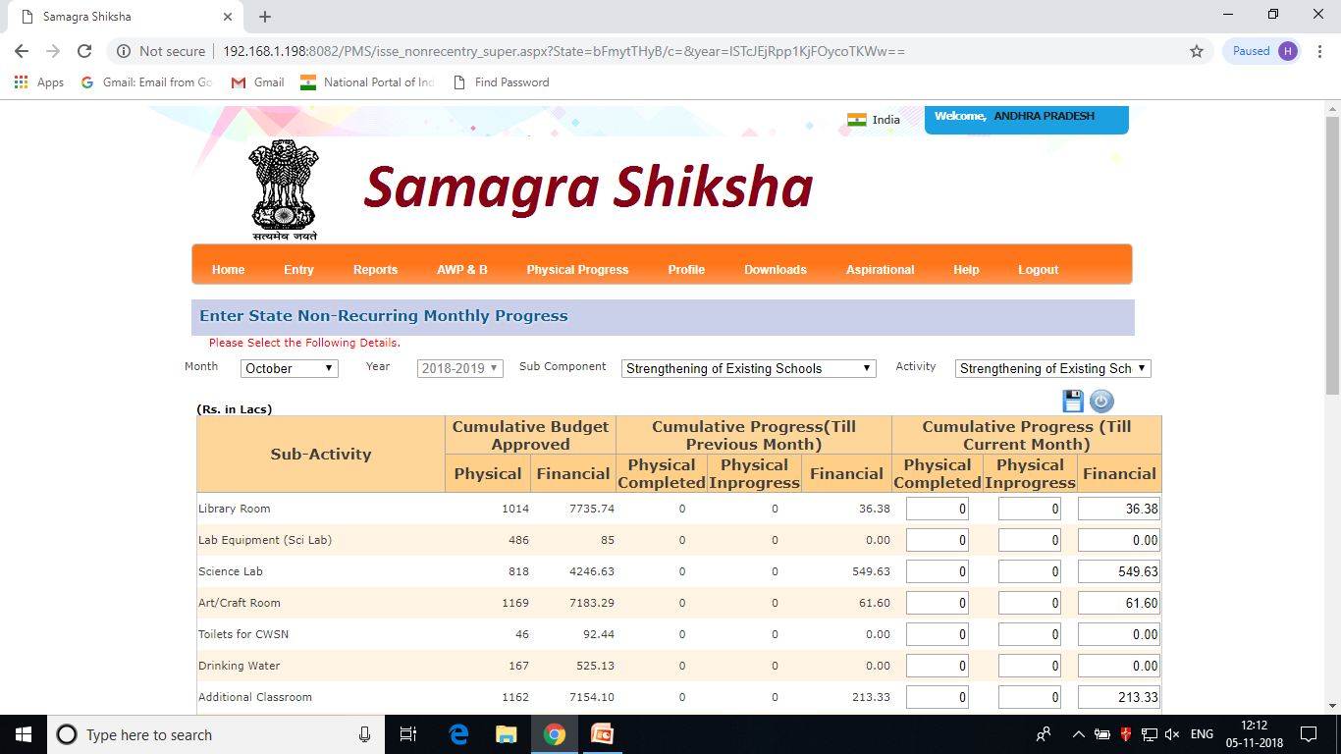
Financial Progress for Non-Recurring
Click on Expenditure → Monthly: Select Financial year : Non- Recurring : After selecting the parameter following screen will appear :

Slide 27
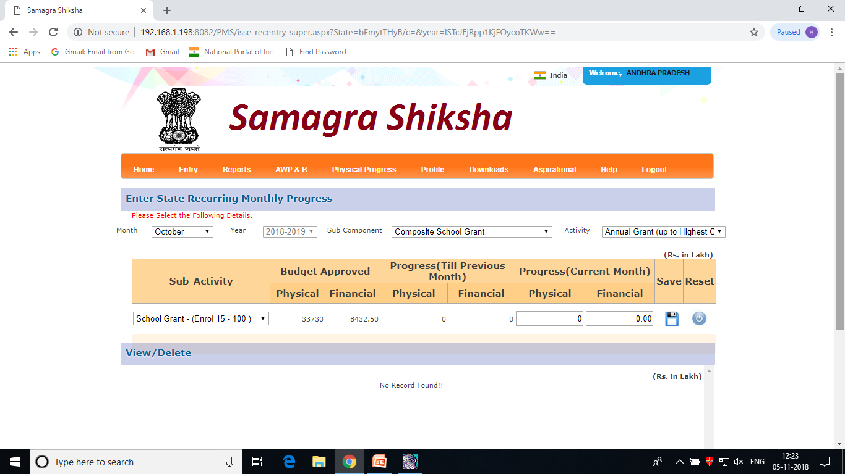
Financial Progress for Recurring
Monthly progressive figure should be entered under Physical and Financial Expenditure for selecting component approved by PAB under Samagra Shiksha
Click on Expenditure → Monthly: Select Financial year : Recurring : After selecting the parameter following screen will appear :

Slide 28
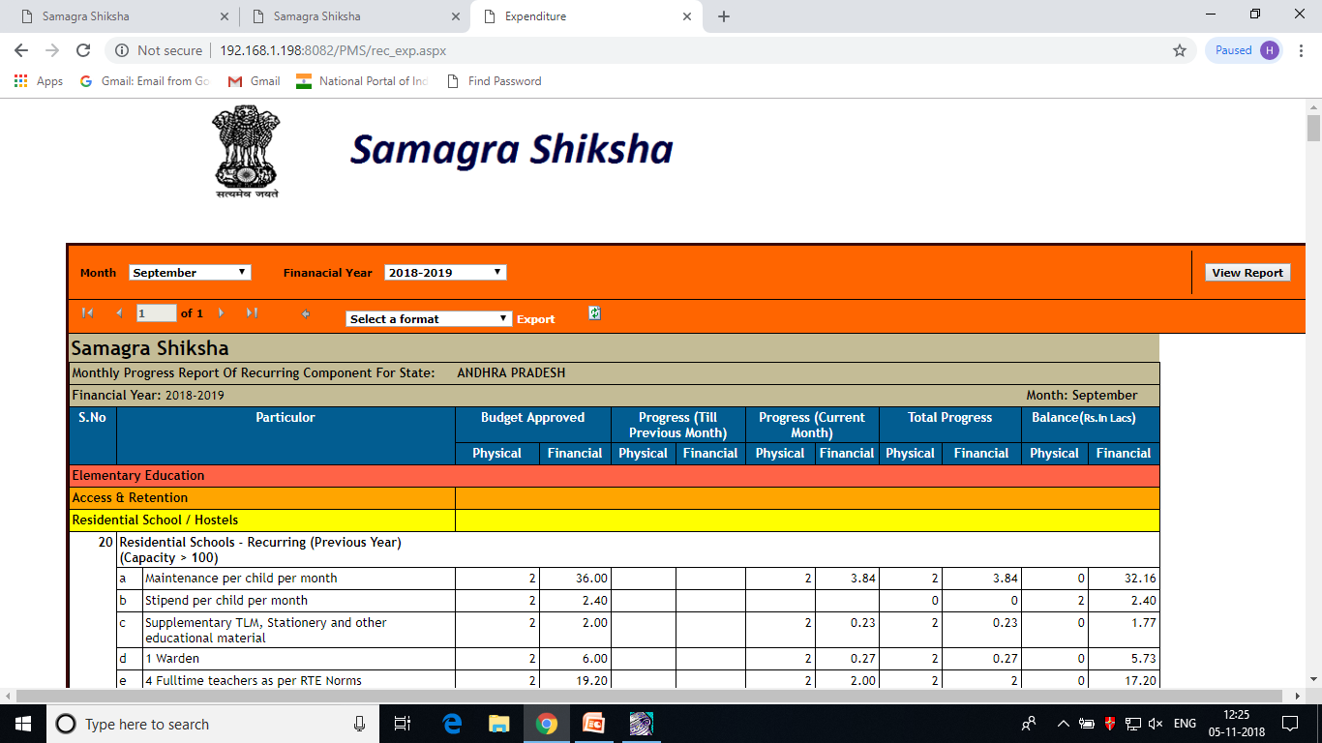
Check the Report
Click on Report → Expenditure : Recurring : After selecting the parameter following report will appear :

Slide 29
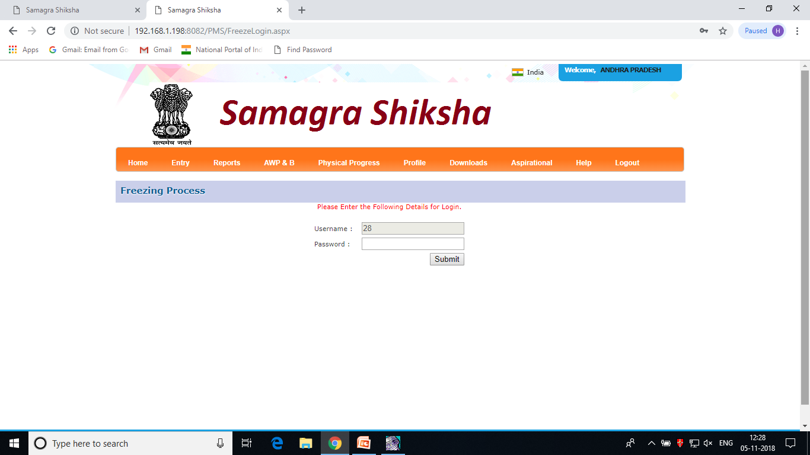
Freeze the Expenditure (NR / R)
Click on Entry → Freeze :
Password : add “ST” with the displayed username as a password

Slide 30
Freezing the Expenditure (NR/R)
Click on Expenditure → Monthly: Select Financial year : NR / R: After selecting the parameter following screen will appear :

Slide 31
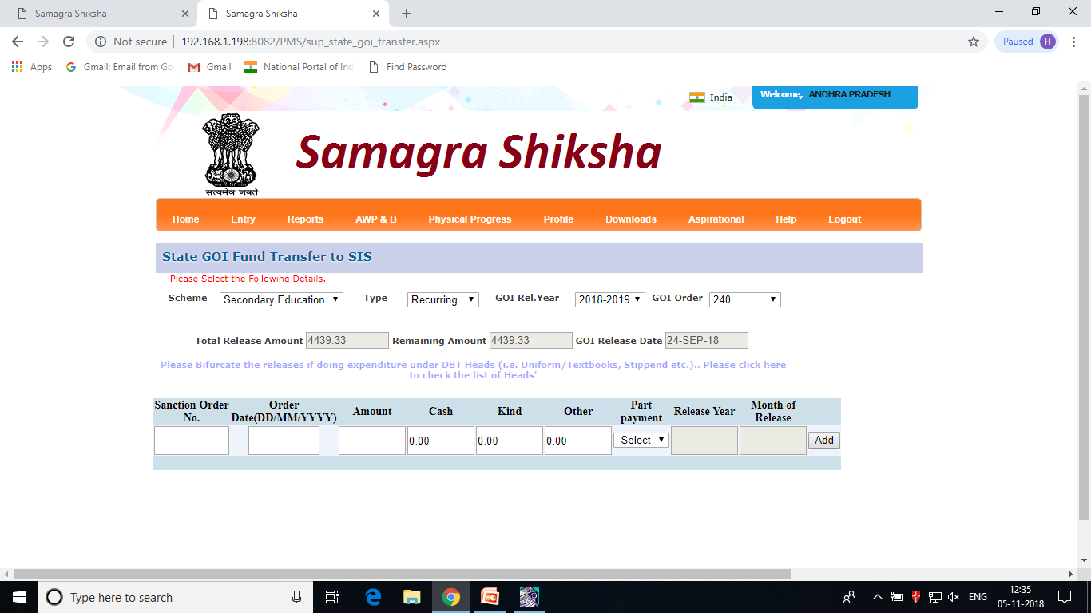
GOI Fund Transfer by State Govt.
Click on Entry → State Release → GOI to SIS : After selecting the parameter following screen will appear :

Slide 32
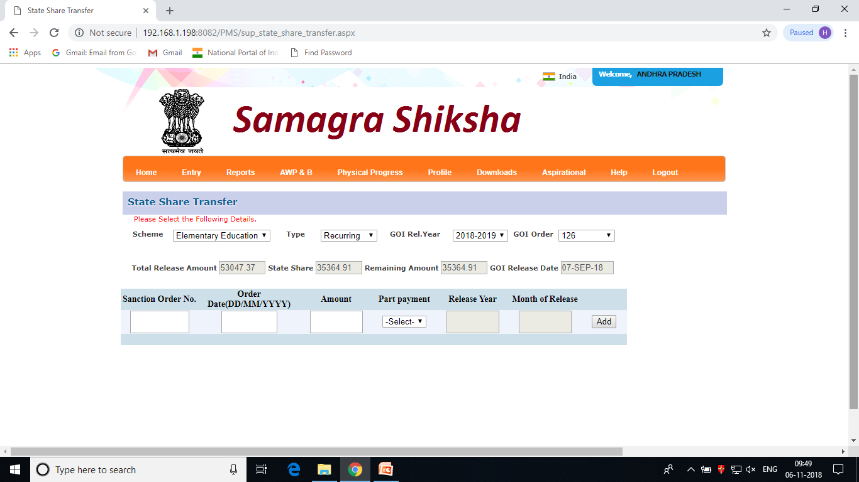
State Share Transfer by State Govt.
Click on Entry → State Release → State Share: After selecting the parameter following screen will appear :

Slide 33
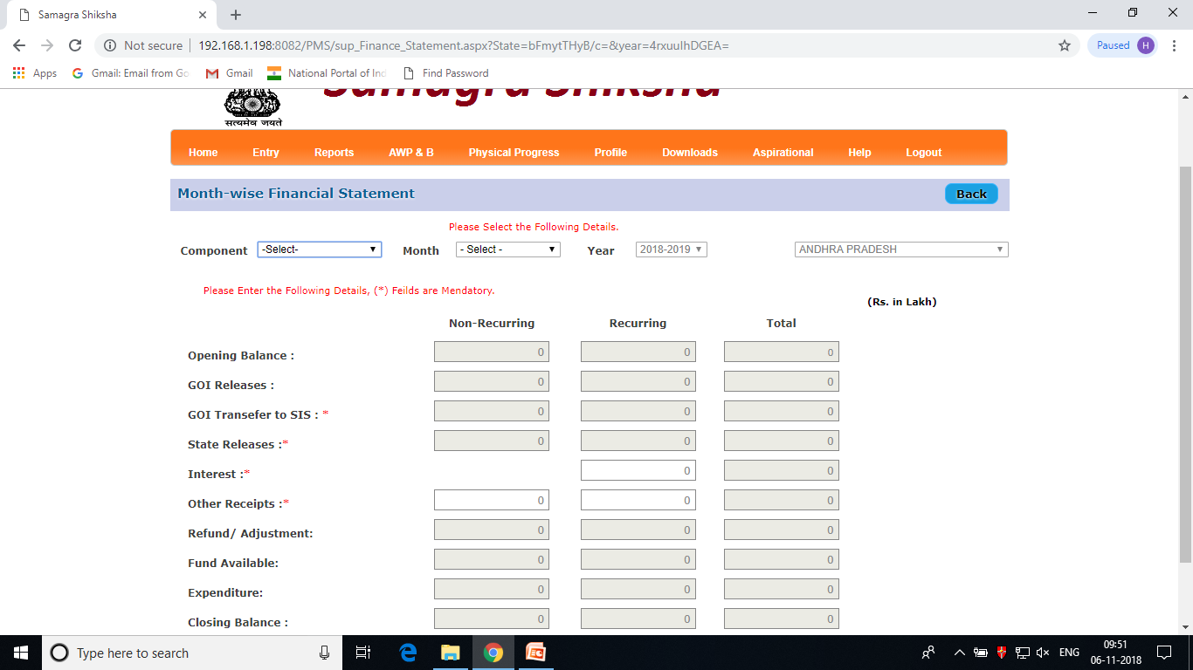
Financial Statement
Click on Entry → Financial Statement: After selecting the parameter following screen will appear :

Slide 34
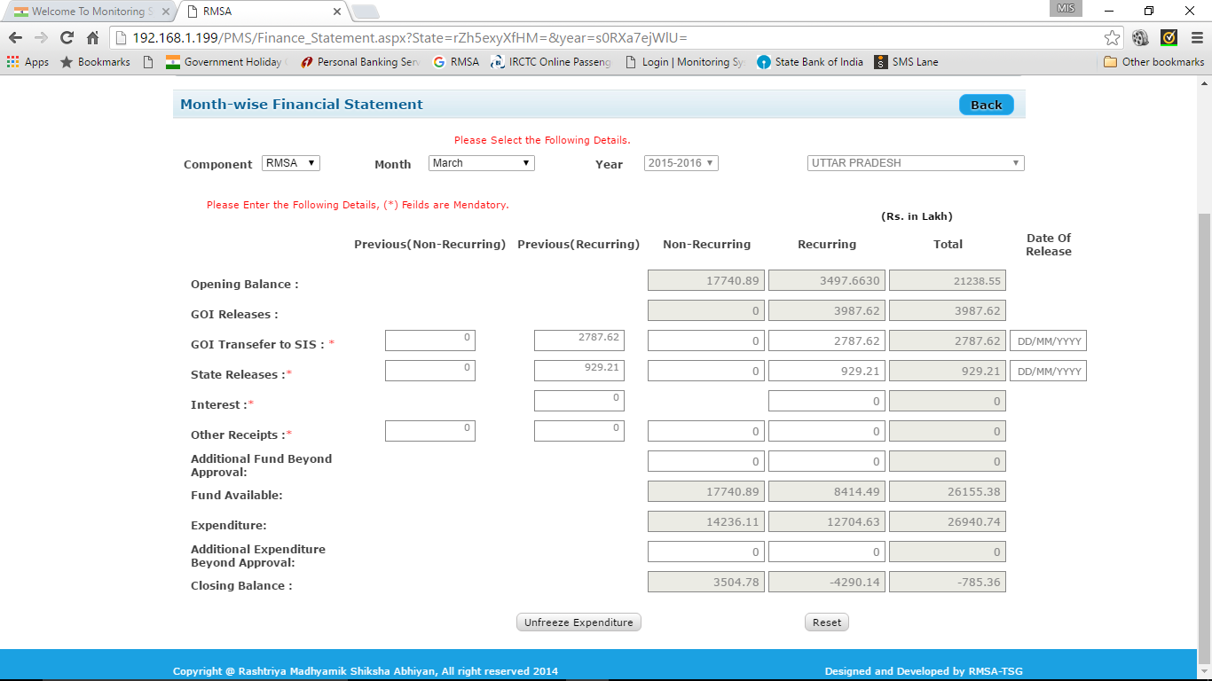
Financial Statement entry Issues
Closing Balance should not be (-)ve
You can change your expenditure for the month by clicking unfreeze button
Submit Button will appear only after having (+)ve closing balance

Slide 35
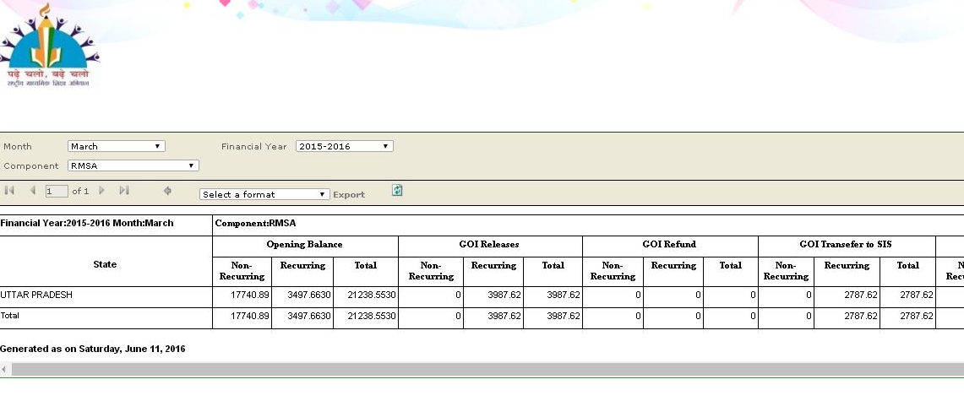
Financial Statement Report Issues
Financial Statement Report Issues
Opening Balance / GOI Releases should matched with your books of accounts

Slide 36
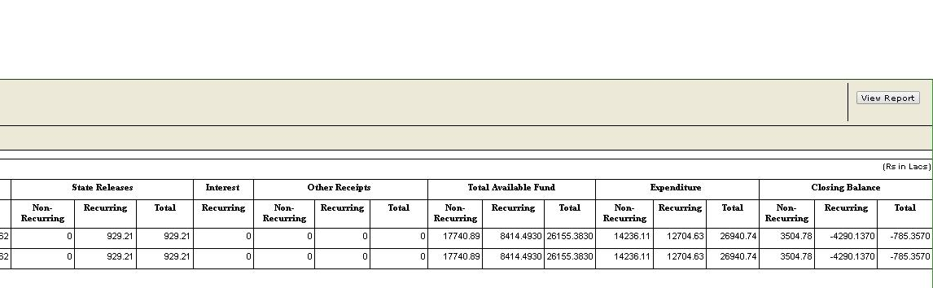
Financial Statement Report Issues
Financial Statement Report Issues
Expenditure : Expenditure is calculated as
Non Recurring : Current Month Cumulative Expenditure – Freezed Expenditure of 31st March Previous Year
Recurring : Sum of current year freezed monthly expenditure
Important Note :
Expenditure once freezed cannot be modified for that month
Expenditure figure once entered cannot be reduced in next month onwards. It should be same or greater than existing figure

Slide 37
Reports under PMS
Approved Outlay
Releases
Statement of Expenditure (SOE)
Spill over
Un-spent balance
Delay Statement
Physical Approvals by PAB
School wise physical progress approved under Civil Work

Slide 38
Project Monitoring System (PMS)
Procedure to enter Audited Expenditure after 31st March’19

Slide 39
Project Monitoring System (PMS)
Send a mail with the component and a year for which you want to get unfreeze to enter the audit expenditure to rmsa.pms@gmail.com
As soon as we receipt a mail , that month will be un-freezed by the team for the component with the financial statements for which request have been sent
State should ensure that the expenditure should be entered and freezed including financial statements by the evening of the next day
After checking the closing balance in Financial Statement
Shift the Audited figure with the provisional figure
Calculate the opening balance

Slide 40
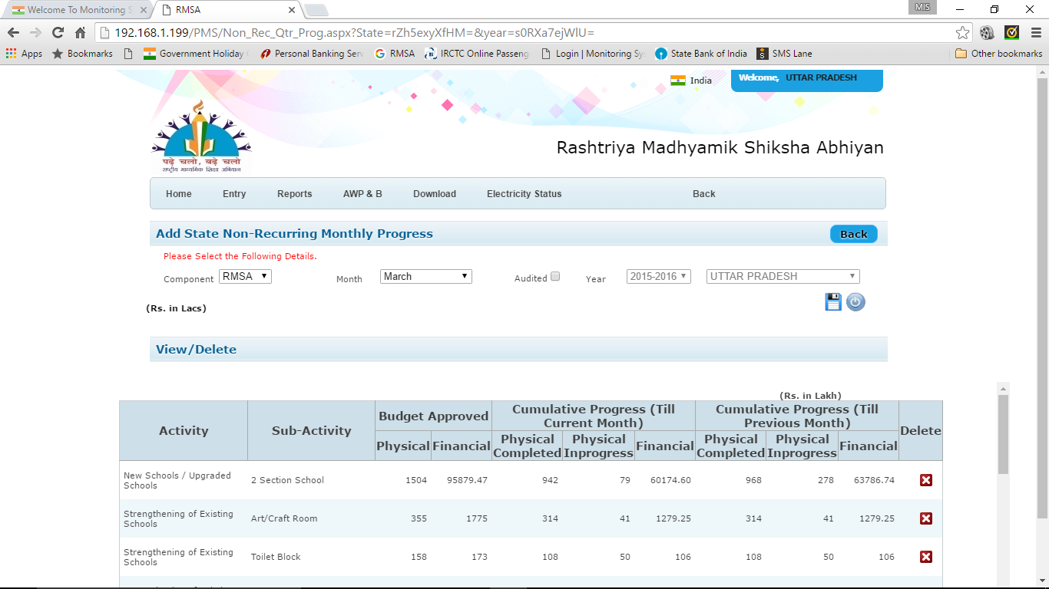
Non-recurring Audited Expenditure
You can enter the less amount after clicking the Audit button

Slide 41
Project Monitoring System (PMS)
Procedure to upload
Annual Work Plan
2019-2020

Slide 42
Project Monitoring System (PMS)
Plan will be uploaded as per previous year using Super login or State User login but,
Before uploading the plan , you have to enter the physical and financial expenditure of 31st March’19 (Provisional) for all 3 component (SSA/RMSA/TE)
After freezing the Financial Expenditure the Spillover was calculated automatically and e-Costing module will be open to upload the proposal

Slide 43
E-Costing Procedure
Tentative Financial Statement of 31st March to be submitted
Detail Activity Wise Proposal to be Submitted by the State for Samagra Shiksha( including Elementary / Secondary / TE)
Uploading Section : State to view the Outlay of the proposal for each component and upload the following documents :
Plan Document
SOR Document
State Go’s (if any)
Training Modules (if any)
Freezing Section :
State will view all the details with uploaded document and finally freeze the Annual Work Plan

Slide 44
Step – a - Head
Integrated UC
Uploading District Wise Plan / e-costing
Expenditure Module for District Users

Slide 45
Assistance
Frequently Asked Questions
PMS Team :
Team Members |  | Contact No.
Rajiv Mehra | Chief Consultant (MIS) | 7827657230
Pooja Magan | Consultant (MIS) | 9818662765
Ajit Kaur | Consultant (MIS) | 9911577170
Divya Singh | Consultant (MIS) | 8358934875
Prashant Dixit | Programmer | 8512898918

Slide 46
Project Monitoring System (PMS)
Discussion – Open Session

